Slide 1

Multi Class EEG Classification
of Motor Imagery Data
Machine Learning and Signal Processing - E599
Jcs Kadupitiya
Malintha Fernando
Sabra Ossen

Slide 2
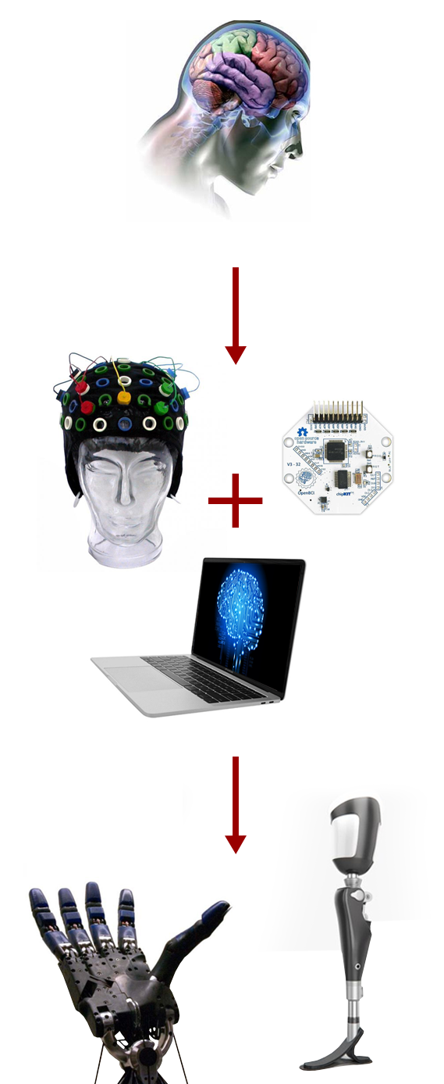
Introduction
Brain-Computer Interface(BCI) provides a new communication platform
Electroencephalography(EEG) Signals
Poor spatial resolution, high degree of noise.
Kinaesthetic imagination of body movement
Responds to µ ( 8−12 Hz) and β (16−24 Hz) frequency bands on sensorimotor cortex.
Applications
Patients with affected neuromuscular system or higher order spinal cord injuries.
Brain-controlled robots
Brainwave virtual reality
Our research
Possibilities identifying four motor movements (left hand, right hand, tongue and foot) from noisy EEG recordings
Experiments and reports the results of a various signal processing techniques.
Notes:
The Brain-Computer Interface(BCI) provides a new communication platform that depends on neither the brain’s normal output cranial nerve system nor the muscles
Due to spatial location differences and volume conduction effect, EEG signal recorded from a specific area of sensorimotor cortex may contain a mixture of several cortical sources resulting poor spatial resolution [5]. Moreover, EEG recordings are often contaminated with a high degree of noise due to the vast number of neuromuscular activities that take place within the body such as eye blinks, eye movements, muscle noises and heart signals [6].

Slide 3
Objectives
Study the existing literature to understand state of art approaches to solve the problem.
Construct the data matrix by selecting the optimal number of channels and frequency bins that suit our approaches.
Perform the feature extraction techniques (PCA, ICA, Random Projection, NMF, PLSI) on frequency domain transformed EEG signal.
Apply final layer classification techniques (KNN, Multilayer perceptron, RNN, Viterbi algorithm, K-means, Naive Bayes, SVM) on obtained feature matrices.
Improve the results by fine tuning and combining the different approaches.

Slide 4
Literature Review
Procedures used in identification of motor imagery movements could be broadly categorized into three phases:
Preprocessing , feature extraction and feature classification
Non-negative matrix factorization based approaches : Binary classification
Lee et al. [9] - Comprehensive evaluation of EEG data using group NMF (GNMF).
Yoo et al. [10] - Semi-supervised NMF (SSNMF) to incorporate the data matrix and the class label matrix into NMF.
Cascade and Parallel Convolutional Recurrent Neural Networks
Zhang et al. [11] - Spatio-temporal representations to enhance EEG-based intention recognition
Common spatial pattern (CSP) : Single channel, three class classification
Ge et al. [3] - STFT for feature extraction, combination of CSP and SVM for classification.
PCA and ICA based approaches : Binary classification
Jung et al. [6]- Highlights that PCA cannot successfully separate eye artifacts from brain signals when eye artifacts contain comparable amplitudes.
Remove the artifact exist in EEG signals using combined PCA whitening and ICA.

Slide 5
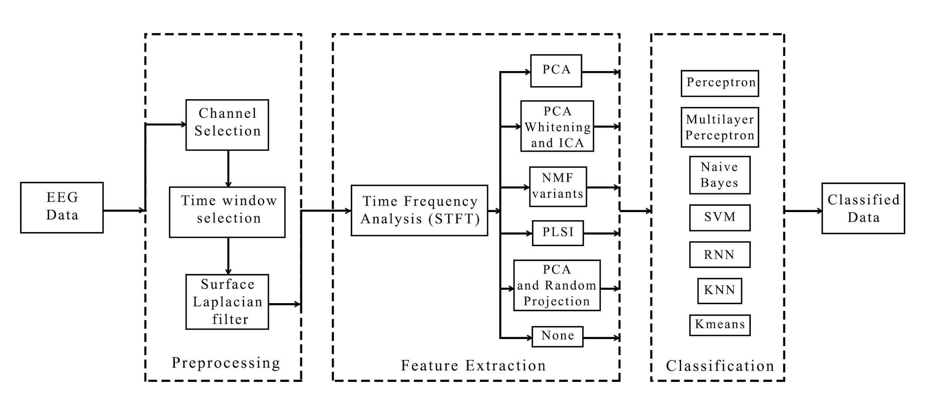
Brief Overview
We use the dataset V (a) from BCI competition III. The dataset consists of EEG signals obtained through 60 electrodes, over 3 subjects for four motor imagery movements. (Tongue, right hand, left hand, a leg)

Slide 6
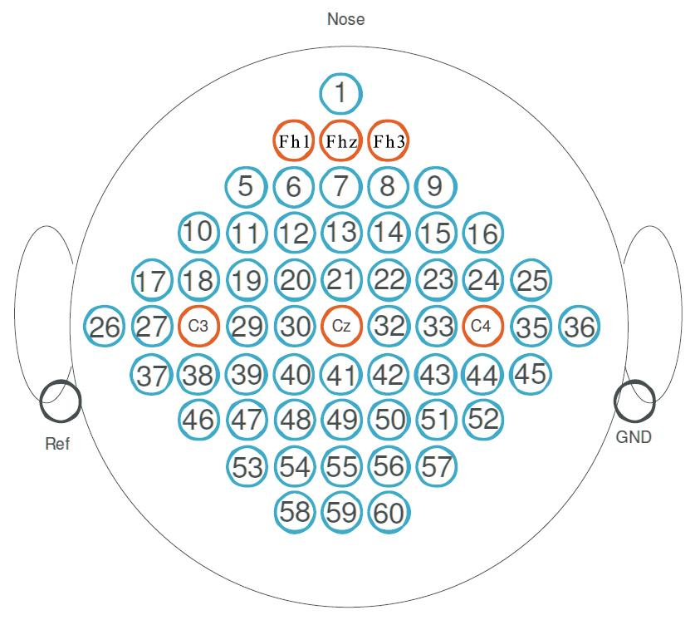
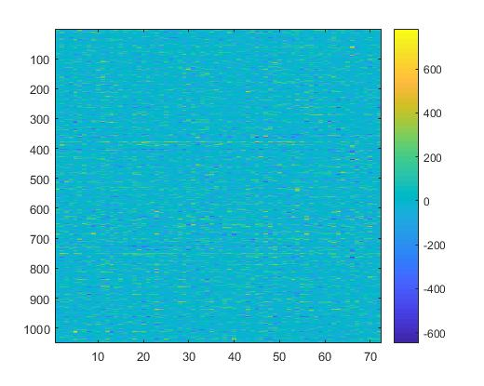
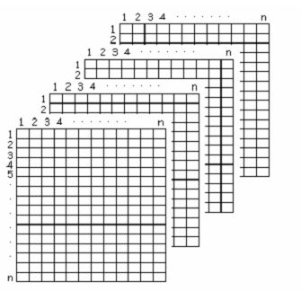
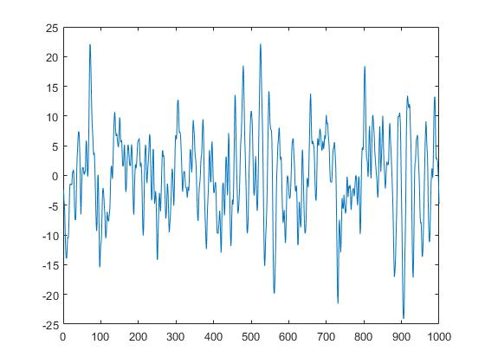
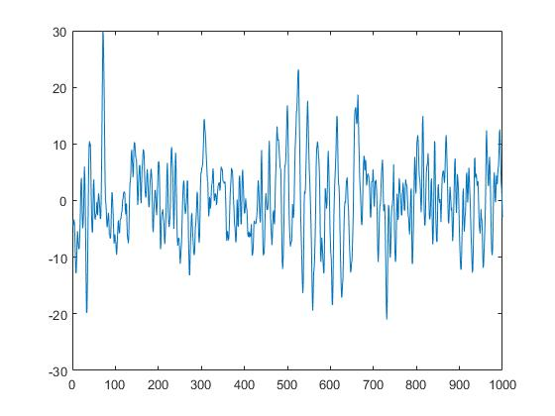
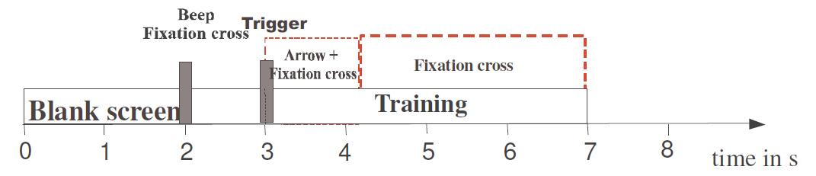
Data acquisition and preprocessing
Frames (1000)
Trials (72)
Figure: Placement of electrodes
Channels (c3, c4, cz)
1050 x 72
Once the cue is shown, frames are captured for 4 seconds at 250 Hz over 60 channels.
Data set consists of multiple trials from 3 different subjects; k3b, k6b, l1b.
We apply STFT on the temporal data at 128 window size and 50% overlap.
We focus only on μ (6-14 Hz) and β (~15Hz) frequency bins over C3, C4 and Cz channels.
Cueing process
Notes:
Why are we only taking 3 channels. How do those channels are arranged in the data matrix. Which frequencies are then considered and why. Image of the imagesc of data matrix.

Slide 7
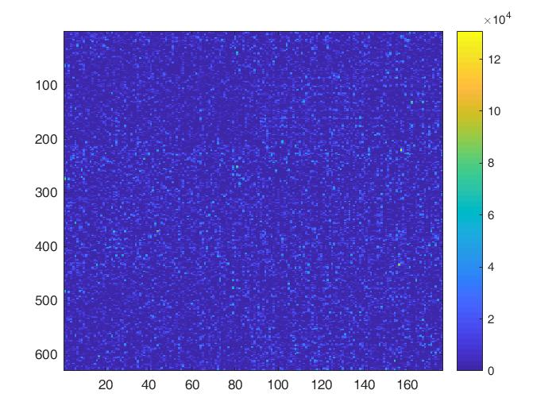
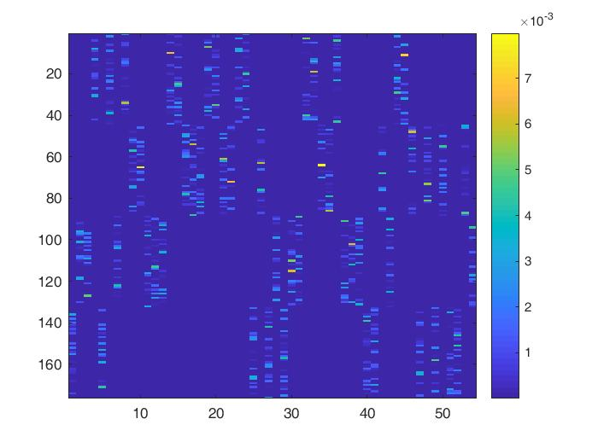
Non Negative Matrix Factorization (NMF)
As an initial experiment, we decomposed X_{(m,n)} ∈ ℝ⁺ into W_{(m,r)}H_{(r,n)} with r basis vectors using the training set in the frequency domain. These basis vectors are then used to learn the activations features, H_{(r,n)} for the test dataset. Then the resulting H_{(r,n)} is fed to a neural network with a single hidden layer (35 hidden units) to do the final layer classification.
Secondly, basis vectors are learnt for each class separately from the training set and followed the same update rules to learn activation features. The final layer classification is updated with early stopping to avoid any over fittings.
Even though those NMF approaches resulted ~75% accuracy for the first subject, the accuracies were dropped to ~50% for other two subjects as it does not account for inter subject features. Hence, GNMF approach will be adopted in order to achieve a higher accuracy.
.
X ≈

Slide 8
Results so far...
Pre-Processing | Feature Extraction Method | Classification Method | Highest Accuracy
None | None | RNN | 0.44
STFT | PCA+Random Projection | Kmeans | 0.5188
 | PCA Whitening + ICA | Single Layer NN | 0.6132
 | None | Multi Layer NN (3) | 0.6814
 | PCA | NB | 0.5
 | None | RNN | 0.5138
 | NMF | NB | 0.583
 | NMF | SVM | 0.583
 | PLSI | Single Layer NN | 0.6881
 | NMF | Single Layer NN | 0.7885

Slide 9
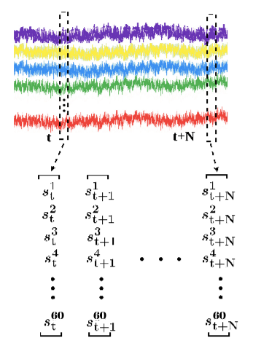
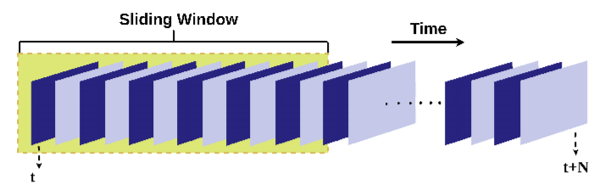
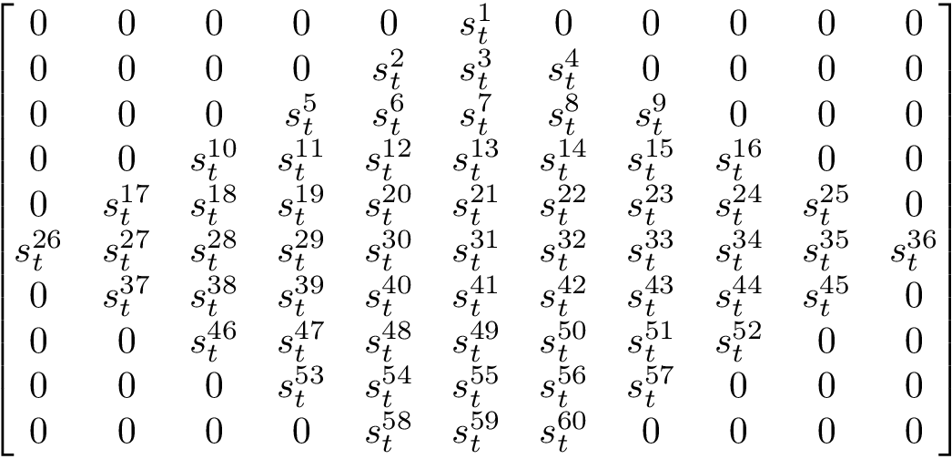
Convolutional and Recurrent Neural Network (CRNN)
The raw EEG signals are transformed into data mesh segments having 50% overlap.
Electrode Map
Data mesh containing values of each channel for one trial, at time t
Data mesh segments
EEG Signals of all channels for one trial

Slide 10
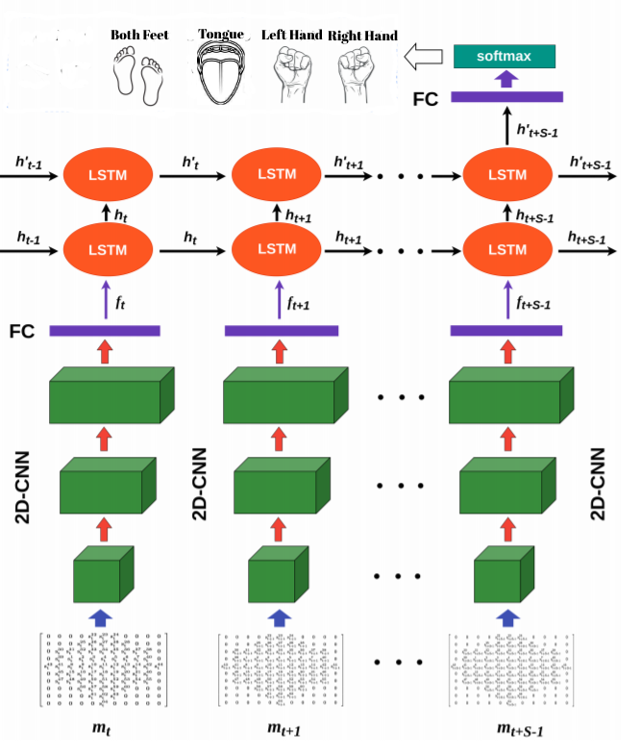
Convolutional and Recurrent Neural Network (CRNN)
Spatial and temporal features of the sequence captured.
Spatial feature extraction - Preprocessed data mesh segments are given as input to the multiple Convolutional Neural Networks (CNN).
Temporal feature extraction - Spatial feature representations are given as input to the Recurrent Neural Network (RNN).
The output of the last LSTM cell is used as input to the fully connected layer.
Softmax layer provides final probability prediction for each class.

Slide 11
References
[1] Birbaumer, N. (2006). Breaking the silence: brain–computer interfaces (BCI) for communication and motor control. Psychophysiology, 43(6), 517-532. [2] Shih, J. J., Krusienski, D. J., & Wolpaw, J. R. (2012, March). Brain-computer interfaces in medicine. In Mayo Clinic Proceedings (Vol. 87, No. 3, pp. 268-279). Elsevier. [3] Ge, S., Wang, R., & Yu, D. (2014). Classification of four-class motor imagery employing single-channel electroencephalography. PloS one, 9(6), e98019. [4] Kaufman, L., Schwartz, B., Salustri, C., & Williamson, S. J. (1990). Modulation of spontaneous brain activity during mental imagery. Journal of Cognitive Neuroscience, 2(2), 124-132. [5] Blankertz, B., Tomioka, R., Lemm, S., Kawanabe, M., & Muller, K. R. (2008). Optimizing spatial filters for robust EEG single-trial analysis. IEEE Signal processing magazine, 25(1), 41-56. [6] Jung, T. P., Makeig, S., Humphries, C., Lee, T. W., Mckeown, M. J., Iragui, V., & Sejnowski, T. J. (2000). Removing electroencephalographic artifacts by blind source separation. Psychophysiology, 37(2), 163-178. [7] http://www.bbci.de/competition/iii/#data_set_iiia [8] Bashashati, A., Fatourechi, M., Ward, R. K., & Birch, G. E. (2007). A survey of signal processing algorithms in brain–computer interfaces based on electrical brain signals. Journal of Neural engineering, 4(2), R32. [9] Lee, H., & Choi, S. (2009, April). Group nonnegative matrix factorization for EEG classification. In Artificial Intelligence and Statistics (pp. 320-327). [10] Lee, H., Yoo, J., & Choi, S. (2010). Semi-supervised nonnegative matrix factorization. IEEE Signal Processing Letters, 17(1), 4-7. [11] Zhang, D., Yao, L., Zhang, X., Wang, S., Chen, W. and Boots, R., 2017. EEG-based Intention Recognition from Spatio-Temporal Representations via Cascade and Parallel Convolutional Recurrent Neural Networks. arXiv preprint arXiv:1708.06578. [12] James, C. J., & Hesse, C. W. (2004). Independent component analysis for biomedical signals. Physiological measurement, 26(1), R15. [13] Kachenoura, A., Albera, L., Senhadji, L., & Comon, P. (2008). ICA: a potential tool for BCI systems. IEEE Signal Processing Magazine, 25(1), 57-68. [14] Liu, Weixiang, Nanning Zheng, and Xi Li. "Nonnegative matrix factorization for EEG signal classification." Advances in Neural Networks-ISNN 2004 (2004): 21-68.

